Slide 1

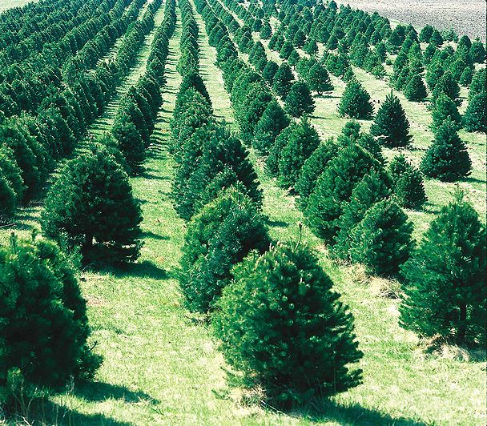
Merry MATHmas!
Ms. Stewart runs a Christmas Tree Farm. There are 5 trees in a row. There are four rows. How many trees are there at Ms. Stewart’s farm?

Slide 2
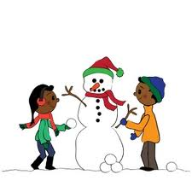
Merry MATHmas!
The snow has finally landed in Stockbridge, GA. The children are so excited to make snowmen. Each snowman must be made using three balls of snow. How many balls would it take to make 6 snowmen?

Slide 3
Merry MATHmas!
The stable door is closed and all you can see is legs under the door. If you see 12 legs, how many reindeer and elves could be in the stable?

Slide 4

Merry MATHmas!
Ms. Cooper decided to make gingerbread cookies for some teachers at SES. How many arms and legs are there on 6 gingerbread cookies? Draw a picture to prove your answer.

Slide 5

Merry MATHmas!
Ms. Parker loves to hang candy canes around the house. On the first day, she hung 2 candy canes. On the second day, she hung 4 candy canes. On the third day, she hung 6 candy canes. How many candy canes will she hang on the 5th day? Hint: Figure out the number pattern!
Challenge! How many candy canes did she hang in all over the 5 days?

Slide 6
Merry MATHmas!
Ms. Booker helps Chippy the Elf make 2 toys a day. How many toys will he make 7 days?

Slide 7
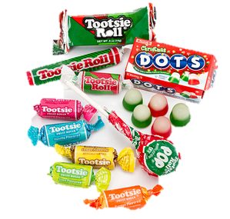
Merry MATHmas!
Ms. Collins has 4 bags of candy. Each bag has 5 pieces. How much candy does he have? Draw a pictures to prove your thinking.

Slide 8



Merry MATHmas!
Ms. Blakely needs help decorating the bottom row of the tree. Follow the pattern to draw a picture to show what the bottom row will look like. Explain your picture and thinking.

Slide 9
Merry MATHmas!
Count the snowmen at the bottom of this page.
If you added another row with 5 more, how many would there be in all?
How many tens and ones?
What would be ten more?
What would be ten less?

Slide 10

Merry MATHmas!
Ms. Addison’s class built 12 snowmen during recess on Monday. 4 melted on Tuesday, and 3 melted on Wednesday. How many snowmen were left?

